Slide 1

Amazon
Prime Data
Analysis
-unlocks insights from streaming data
POWER BI
SPANDANA N S 21/11/2024

Slide 2

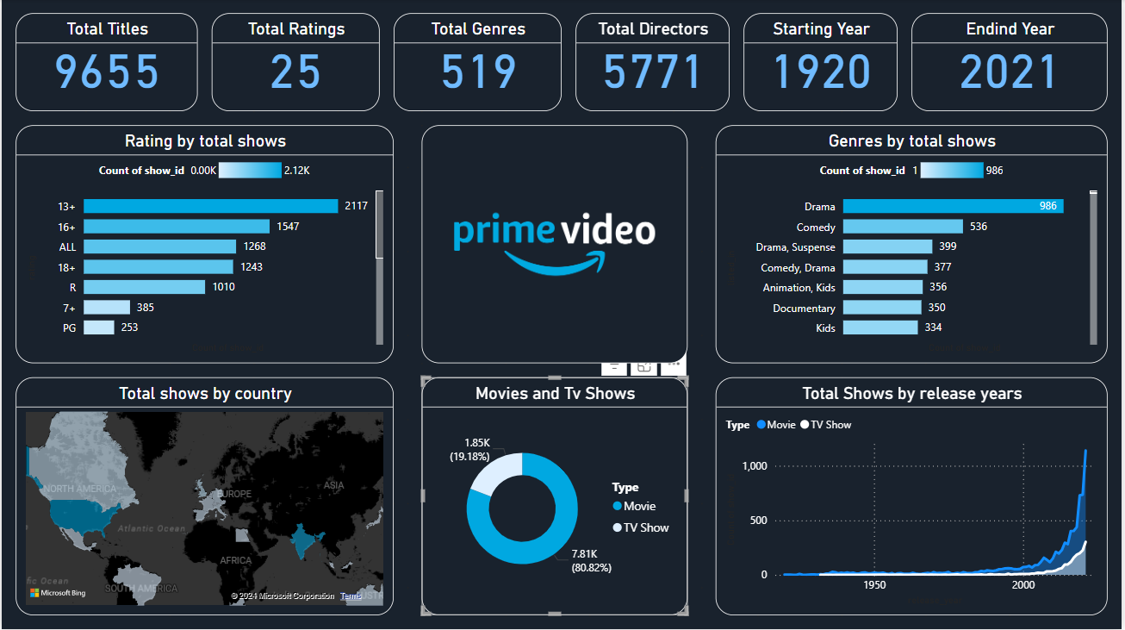
About this Project
In this Project, I created a Power BI report/dashboard using Amazon Prime video streaming data set (2021) found on internet.

Slide 3
About the Dataset
Before Creating a Power BI Dashboard we need to analyse the Dataset.
This Data set Contain various Data related to Amazon Prime Video Streaming.
The dataset contains following Fields.
Show id : Every show has the unique Id
Type : it classifies the show type in Movie or Tv show
And it contains following fields like (movie or tv show ) Title, Cast, Director, Release date, Duration ,genre ,Description about the Movie/Tv Show
Rating : It classifies the age category suitable for movie watching.

Slide 4
Visualizations Used in Power BI Dashboard
1.Card
A Card is a way to enhance the data in a card form. It can be used to display aggregate metrics such as count, the maximum number of leads, the first, the last, and so on.
Based on my Project, I Used Cards to display the following metrics.

Slide 5
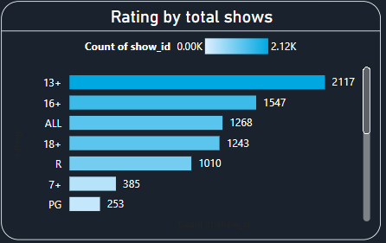
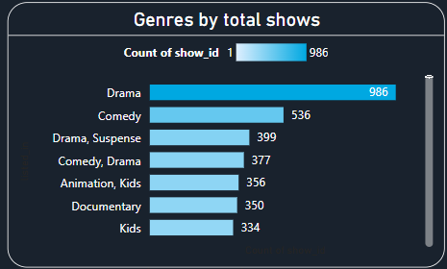
2.Stacked bar chart
A stacked bar chart is a type of bar chart that portrays the compositions and comparisons of several variables with values.
Based on my Project, I Used stacked bar chart to display the following metrics.
Here I used stacked bar chat in two cases.

Slide 6
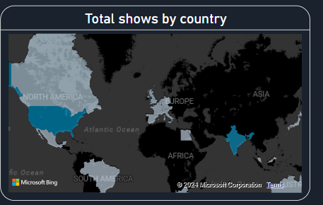
3.Filled Map
A filled map uses shading, tinting, or patterns to display how a value differs in proportion across a geography or region.
Here I used it in following scenario.

Slide 7
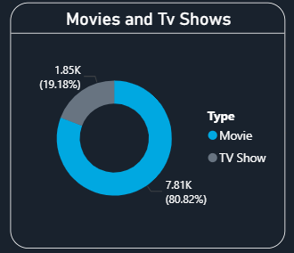
4.Donut Chart
A donut chart is a type of pie chart that features a hole in the center, similar to a donut. Donut charts present categories in the form of arcs instead of slices.
Here I used it in following case.

Slide 8
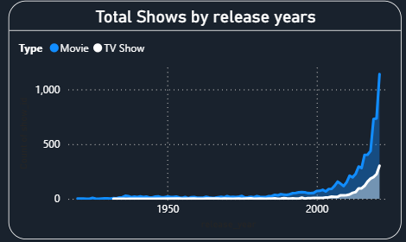
5.Area Chart
The area chart is based on line Chart and to see and compare the volume trend across a time series.
Here I used it in following case.
Thank You...

